Slide 1
PISA for Development
Technical Strand 2:
Cognitive instruments
Overview of PISA instruments
(frameworks, proficiency levels and items)
EDU/DCD

Slide 2
PISA for Development Cognitive instruments
What does PISA assess?
How is PISA designed and conducted?
How is the assessment developed?
What will PISA for Development seek to accomplish?
Questions for discussion

Slide 3
PISA for Development What does PISA assess?
Domains
PISA is a combination of a cognitive test and contextual instruments
It aims to assess cognitive and non-cognitive student outcomes → analytical framework
PISA is a combination of cognitive test questions and contextual instruments
It aims to assess cognitive and non-cognitive student outcomes (analytical framework)
PISA Analytic Framework guides data collection and analysis
Outputs and Outcomes impact of learning
Policy Levers shape educational outcomes
Antecedents contextualise or constrained policy
Individual learner
Quality and distribution of knowledge & skills
Individual attitudes, engagement and behaviour
Socio-economic background of learners
Instructional settings
Quality of instructional delivery
Teaching, learning practices and classroom climate
Student learning, teacher working conditions
Levels of an education system
Schools (other institutions)
Output and performance of institutions
The learning environment at school
Community and school characteristics
Country or system
Social & economic outcomes of education
Structures, resource allocation and policies
National educ., social and economic context

Slide 4
PISA for Development What does PISA assess?
Core assessment of content knowledge, competencies and skills in
Reading
Mathematics
Science
Other assessment areas as options: financial literacy, problem solving, digital reading, and reading components
Beyond assessing whether students can reproduce knowledge to how well they can extrapolate from what they have learned and apply it in unfamiliar settings (within and outside of school)

Slide 5
PISA for Development What does PISA assess?
Mathematical literacy
…an individual’s capacity to formulate, employ, and interpret mathematics in a variety of contexts. It includes reasoning mathematically and using mathematical concepts, procedures, facts, and tools to describe, explain, and predict phenomena. It assists individuals to recognise the role that mathematics plays in the world and to make the well-founded judgments and decisions needed by constructive, engaged and reflective citizens.

Slide 6
PISA for Development How is the assessment designed and conducted?
There are main and minor assessment domains in 3-year cycles (reading was the main domain in 2009, mathematics in 2012 and science in 2015)
Each cycle, approximately 270 minutes of testing material (for the main domain) and 90 minutes of assessment time (for minor domains) → paper and pencil assessment with rotated booklets
Experience for students: 2 hours of test questions and ~30 minutes for student questionnaire (total time is ~3.5 hours)

Slide 7
PISA for Development How is the assessment designed and conducted?
PISA 2012 - Booklet design of cognitive test questions
22 Booklets in total
13 standard booklets
option for countries to administer 7 easier booklets
2 UH booklets (“une heure booklets”)
Clusters
7 mathematics clusters 3 reading clusters, 3 science clusters,
9 mathematics clusters available: 3 with link items, 4 with new items and 2 easier clusters
2 financial literacy clusters
Each cluster ~ 30 minutes of test time
Notes:
18 reading units and 18 science units in the 3 clusters for each. 90 minutes of assessment for each (minor domains)

Slide 8
PISA for Development How is the assessment designed and conducted?
Booklet ID | Cluster |  |  |  | standard | easier
 |  |  |  |  | booklet set | booklet set
B1 | PM5 | PS3 | PM6A | PS2 | Y
B2 | PS3 | PR3 | PM7A | PR2 | Y
B3 | PR3 | PM6A | PS1 | PM3 | Y
B4 | PM6A | PM7A | PR1 | PM4 | Y
B5 | PM7A | PS1 | PM1 | PM5 | Y
B6 | PM1 | PM2 | PR2 | PM6A | Y
B7 | PM2 | PS2 | PM3 | PM7A | Y
B8 | PS2 | PR2 | PM4 | PS1 | Y | Y
B9 | PR2 | PM3 | PM5 | PR1 | Y | Y
B10 | PM3 | PM4 | PS3 | PM1 | Y | Y
B11 | PM4 | PM5 | PR3 | PM2 | Y | Y
B12 | PS1 | PR1 | PM2 | PS3 | Y | Y
B13 | PR1 | PM1 | PS2 | PR3 | Y | Y
B20 (UH) | PMUH | PRUH | PSUH
B21 | PM5 | PS3 | PM6B | PS2 |  | Y
B22 | PS3 | PR3 | PM7B | PR2 |  | Y
B23 | PR3 | PM6B | PS1 | PM3 |  | Y
B24 | PM6B | PM7B | PR1 | PM4 |  | Y
B25 | PM7B | PS1 | PM1 | PM5 |  | Y
B26 | PM1 | PM2 | PR2 | PM6B |  | Y
B27 | PM2 | PS2 | PM3 | PM7B |  | Y
B70 (FLUH) | PFUH | PMUH
B71 | PF1 | PF2 | PM5 | PR2
B72 | PF2 | PF1 | PR2 | PM5
B73 | PM5 | PR2 | PF1 | PF2
B74 | PR2 | PM5 | PF2 | PF1
Cluster rotation design of booklets
(possible area of modification in PISA for Development)

Slide 9
PISA for Development How is the assessment developed?
Participation of expert groups
Subject matter expert group (SMEG)
Reading (REG)
Math (MEG)
Collaborative problem solving (CPEG)
Science (SEG)
Questionnaire (QEG)
Financial (FL)
Membership ranges from 4 to 14 experts per group

Slide 10
PISA for Development How is the assessment developed?
Assessment frameworks are updated and revised in every cycle of PISA
The 2012 Mathematics Framework
Developed by Math expert group (MEG)
Circulated for feedback to over 170 mathematics experts from over 40 countries
Approved by the PISA Governing Board

Slide 11
PISA for Development How is the assessment developed?
Item Development
Experts developing items that will enable us to measure the skills/competencies/concepts defined in the framework
In PISA 2012
New development of mathematics items
No new item development for reading or science
Participating countries submit items and review items. Country input and international validation are crucial to achieve a cross-culturally valid assessment
Field trial is conducted (before MS) to select items
Link items for comparisons to previous cycles

Slide 12
PISA for Development How is the assessment developed?
International item development process
International item development teams go through several stages of item development (e.g. cognitive labs, walkthroughs, panels, etc.)
Countries can also submit items for international review
Item review (Are items culturally neutral? Other potential issues with items?)
Validation of psychometric equivalence of translated items (and adaptations from source versions) → issues addressed
Evaluate item parameters from field trial (e.g. international consistency, DIF analyses)
Item selection for main study: framework coverage, item difficulties, item parameters, cross-culturally valid

Slide 13
PISA for Development How is the assessment developed?
Formats of PISA cognitive items
Multiple-choice items
Standard multiple choice (4 and in some cases 5 responses)
Complex multiple-choice (present several statements and for each students choose one of several responses (yes/no, true/false, correct/incorrect ….)
Constructed response items
Closed-constructed response
Short response
Open-constructed response

Slide 14
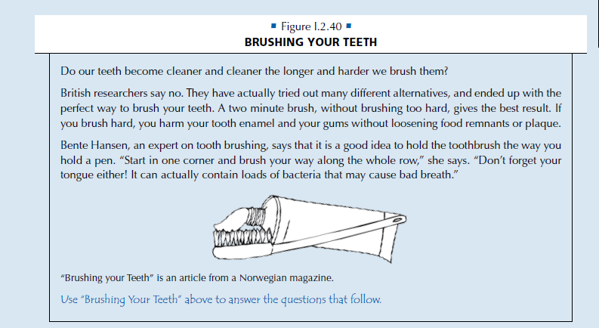
Importance of PISA Proficiency Levels
Example item 1: Reading

Slide 15
Importance of PISA Proficiency Levels
Example item 1: Reading
What is this article about?
The best way to brush your teeth.
The best kind of toothbrush to use.
The importance of good teeth.
The way different people brush their teeth.
Points | Level
 | Level 6
698
 | Level 5
626
 | Level 4
553
 | Level 3
480
 | Level 2
407
 | Level 1a
335
 | Level 1b
262
 | Below Level 1b
Difficulty: 358 (Level 1A item)
93.7% of students across OECD can perform tasks at least at this level

Slide 16
Importance of PISA Proficiency Levels
Reading
OECD
Others…
Students at Level 5 can handle texts that are unfamiliar in either form or content. They can find information in such texts, demonstrate detailed understanding, and infer which information is relevant to the task. They are also able to critically evaluate such texts and build hypotheses about them, drawing on specialised knowledge and accommodating concepts that may be contrary to expectations.
Level 6
0.8%
? %
Level 5
6.8%
%
Level 4
21%
%
Level 3
29%
%
24%
%
Students at Level 1a are capable of locating pieces of explicitly stated information that are rather prominent in the text, recognising a main idea in a text about a familiar topic, and recognising the connection between information in such a text and their everyday experience.
Level 2
Level 1a
13%
%
Level 1b or below
5.7%
%

Slide 17
PISA for Development How is the assessment developed?
… Recognising the need to provide countries with a better understanding of student performance at the lower end of the proficiency scale, PISA developed the reading components assessment
(Invited Expert from ETS)

Slide 18
PISA for Development
Kentaro Yamamoto
Component reading skills assessment

Slide 19
PISA Contextual Questionnaires What will PISA for Development seek to do?
Technical Strand of Work for Output 2
Enhance the descriptive power of cognitive assessments in reading, mathematics and science, particularly with regards to students performing below baseline proficiency levels in PISA.

Slide 20
PISA for Development How will we do this?
Review the available pool of PISA test items
Identify a selection of appropriate items (i.e. test-targeting) and construct booklets accordingly
Obtain input and advice from experts on test-targeting and balanced booklet designs
Obtain input and comments from participating countries regarding item selection
Draw on existing work and evidence from relevant studies
Test and validate item selection and booklet design

Slide 21
PISA for Development Questions for discussion
Are the intentions and rationale of this strand of work clear and understood?
What do you see as the largest hurdle to overcome?
What existing studies, evidence and lessons should contribute to this strand of work?

Slide 22
PISA for Development
Technical Strand 2:
Cognitive instruments

